Slide 1
Suspicious Bangla Text Detection
Using Machine Learning
Presented by :
Omar Sharif
ID: 1304003
Supervised by:
Dr. Mohammed Moshiul Hoque
Professor
Department of CSE, CUET

Slide 2
List of Contents
    Introduction
    Motivation
    Challenges
    Contributions
    Related Work
    Implementation
    Experimental Results
    Limitations
    Future Improvements
    Conclusion
    References

Slide 3
Introduction
Text classification (categorization) is the task of assigning a document to a category.
Detecting suspicious text is typically a text classification problem where we have to classify a text as suspicious and not suspicious.
Suspicious text detection is a kind of system where suspicious texts are identified by the keywords used in the text body.

Slide 4
Motivation
A great number of researchers focused on the area of counter terrorism are trying to predict terrorist plan from suspicious communication.
As most of our communications are text based, If we able to predict either a text is suspicious or not suspicious it will be very helpful for our law enforcement agencies to find the perpetrator and stop terrorist event.

Slide 5
Motivation (Contd.)
To the best of our knowledge, no system is developed
for detecting suspicious text in Bangla.
For the safety of Bangladeshi people a system is needed to detect suspicious communication in Bangla.
This motivated us to work in this project.

Slide 6
Challenges
Developing a well furnished dataset which can be used to train our system.
Labeling the collected text data into suspicious and non suspicious category.
Hardware support.

Slide 7
Contributions
A system is designed that can detect suspicious Bangla text using machine learning algorithm.
A corpus is developed which contains approximately 3500 suspicious Bangla text.

Slide 8

Related Work
    A lot of works has already been done on text classification regarding English language.
    Major works of text classification are Email classification, Research paper categorization, Detecting suspicious profiles etc.
    M. R. Hossain et al. describes Bengali document categorization based on word embedding and statistical learning approach.

Slide 9
Implementation
Our model for detecting Suspicious Text.
Training Text Documents
Preprocessing
Stop Word List
Feature Extraction
Classification
Algorithm
Label of Text
Learned Classifier
Suspicious
New Text Document
Feature Vector
Not Suspicious

Slide 10
Implementation(Contd.)
Training dataset is divided into positive set (suspicious text) and negative set (ordinary text).
Main bodies of texts will be used to train the suspicious text detector. Header information will be discarded.
Words which makes no contribution in detecting suspicious text will be removed by matching with a predefined stop word list.

Slide 11
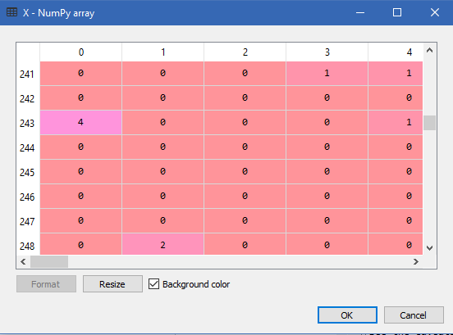
Implementation(Contd.)
Word frequencies are used as features of our system.
Bag of Words (BoW) model is used to represent our features.

Slide 12
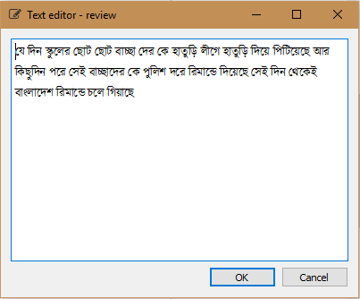
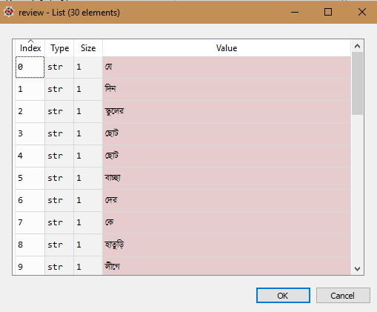
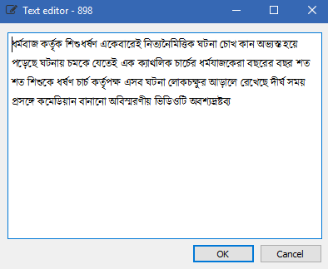
Implementation (Contd.)
Sample Training Text
Tokenization of Text
Processed Text
Input Feature
Classifier Model

Slide 13
Implementation (Contd.)
Sample Test Text
Feature of Test Text
Learned Classifier Model
Suspicious
Non Suspicious

Slide 14
Experimental Results
Six different machine learning algorithm is used to train our system.
Algorithm | Accuracy | Error
Naïve Bayes | 0.85 | 0.15
SVM (Linear Kernel) | 0.91 | 0.09
SVM (RBF Kernel) | 0.90 | 0.10
Logistic Regression | 0.92 | 0.08
K-Nearest Neighbor | 0.73 | 0.27
Decision Tree | 0.88 | 0.12

Slide 15
Experimental Results (Contd.)
Average Precision, Recall and F1 score of each algorithm used in our system.
Algorithm | Precision | Recall | F1 score
Naïve Bayes | 0.89 | 0.85 | 0.85
SVM (Linear Kernel) | 0.91 | 0.91 | 0.91
SVM (RBF Kernel) | 0.90 | 0.91 | 0.90
Logistic Regression | 0.91 | 0.93 | 0.93
K-Nearest Neighbor | 0.82 | 0.73 | 0.70
Decision Tree | 0.88 | 0.92 | 0.89

Slide 16
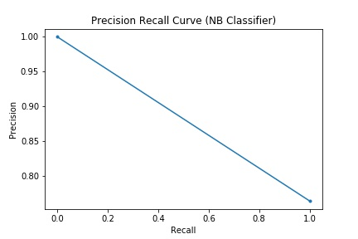
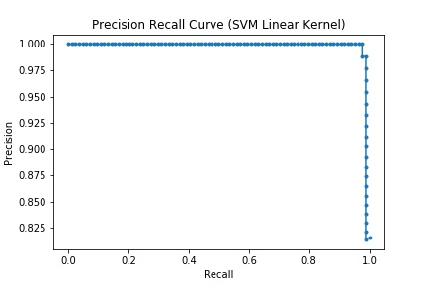
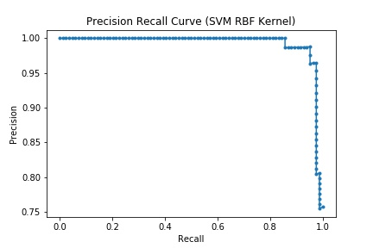
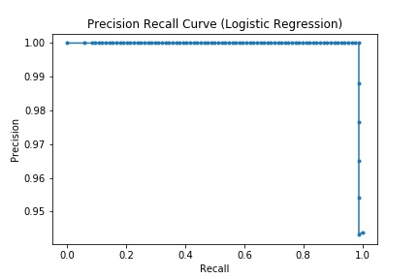
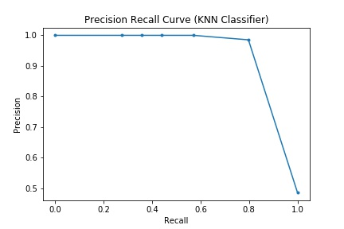
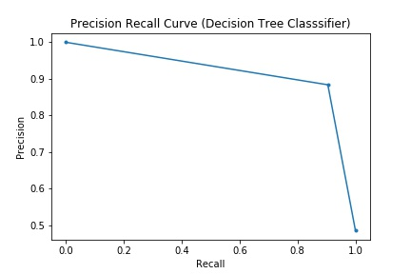
Experimental Results (Contd.)

Slide 17
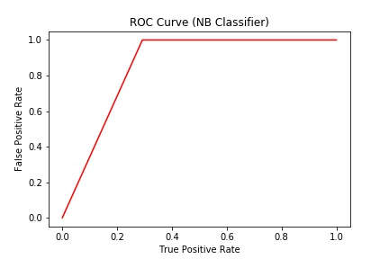
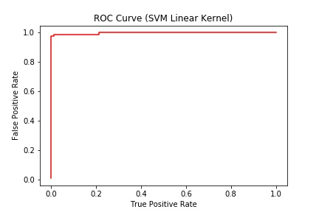
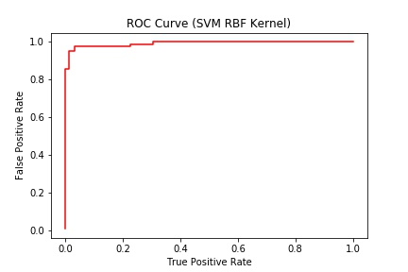
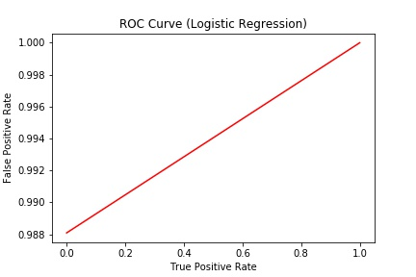
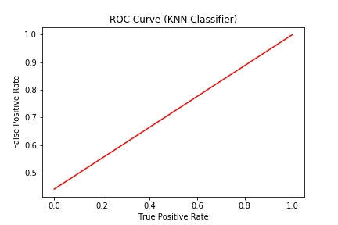
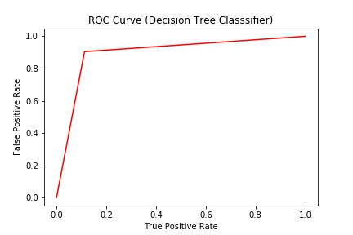
Experimental Results (Contd.)

Slide 18

Limitations
Semantic relation between words in a sentence is not considered in our system.
Difficult to handle large amount of data.
Long training time.

Slide 19
Future Improvements
We will use deep learning approach to find semantic relations between words of a text for more accurate prediction.
Our final goal is to develop a web based system that can filter different online posts, writings and alert about suspicious
activities.
Include more data at corpus.

Slide 20
Conclusion
A system is developed that can classify Bangla text into suspicious and non suspicious category.
Our system obtains maximum accuracy of 92% for
Logistic Regression.
We hope that, our system will help law enforcement agencies in reducing criminal activities.

Slide 21
References
[1] H. Zhang, D. li, “Naïve Bayes Text Classifier”, 2007 IEEE International Conference on Granular computing.
[2] L. Wei, B. Wei, and B. Wang. "Text classification using support vector machine with mixture of kernel." Journal of Software Engineering and Applications 5 (2012): 55.
[3] S. Appavu, R. Rajaram, “Suspicious email detection via decision tree: a data mining approach”. Journal of Computing and Information Technology -CIT 15 .pp. 161-169. (2007).
[4] O. Cokluk. "Logistic Regression: Concept and Application." Educational Sciences: Theory and Practice 10, no. 3 (2010): 1397-1407.
[5] T. Villmann, A. Bohnsack, and M. Kaden. "Can Learning Vector Quantization be an alternative to SVM and Deep Learning? -Recent trends and advanced variants of Learning Vector Quantization for classification learning." Journal of Artificial Intelligence and Soft Computing Research 7, no. 1 (2017): 65-81.

Slide 22
References(Contd.)
[6] J. Sreemathy and P. S. Balamurugan. "An efficient text classification using KNN and naive bayesian." International Journal on Computer Science and Engineering 4, no. 3 (2012): 392.
[7] S. Nizamani, N. Memon, U. K. Wiil, and P. Karampelas. "Modeling suspicious email detection using enhanced feature selection." arXiv preprint arXiv:1312.1971 (2013).
[8] P. Pradhan, S. Misra, and T. Koirala. "A Survey on Data Security in Social Networking Sites." International Journal of Computer Applications 155, no. 7 (2016).
[9] S. Alami, and O. E. BEQQALI. "DETECTING SUSPICIOUS PROFILES USING TEXT ANALYSIS WITHIN SOCIAL MEDIA." Journal of Theoretical & Applied Information Technology 73, no. 3 (2015).
[10] M. Murugesan, R. Suruthi, P. Devi, S. Deepthi, V. S. Lavanya, and A. Princy. "Automated Monitoring Suspicious Discussions on Online Forums Using Data Mining Statistical Corpus Based Approach." Imperial Journal of Interdisciplinary Research 2, no. 5 (2016).

Slide 23
Thank You

